Slide 1

BUCKSBUDDY
ANISH NAVALE
APARNA CHAVAN
SHANTANU PINGALE

Slide 2
PROBLEM
Overwhelmed by stock market complexity.
Data overload deters confident investment.
New investors face a steep learning curve.
Lack of easy-to-use analytical tools.
The need for accessible, reliable market insights.

Slide 3
SOLUTION
Buck$Buddy uniquely integrates multiple AI models and real-time social media data to provide comprehensive and up-to-date stock analyses, making complex investment decisions clear and accessible for all users.
Notes:
Buck$Buddy is an AI-assisted app that offers streamlined stock analysis and predictions, making investment decisions clear and accessible for everyone.

Slide 4
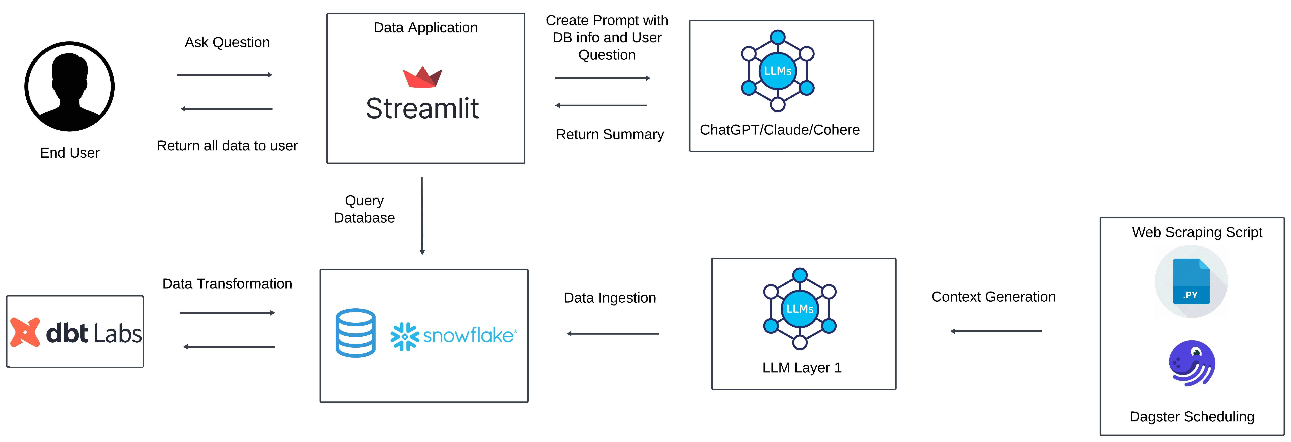
DATA ARCHITECTURE

Slide 5



DATA COLLECTION
Irrelevant hence discarded. Contained Media Files

Slide 6

DATA TRANSFORMATION
Direct Integration: Yahoo Finance data integrated directly, ensuring timely and unaltered information.
Focused Data Processing: DBT applied to refine Reddit data for relevance.
Relevance Filtering: Targets only stock-related discussions on Reddit.
Stock-Specific Insights: Transforms data to yield key insights for accurate predictions

Slide 7



LLMs EXPLORED

Slide 8
PROMPT ENGINEERING
You are a world-class financial assistant providing in-depth insights into company financials, stock data and investment tips. Using the following information: {context}, answer questions with in-depth and holistic analysis.
As a premier financial assistant specializing in company financials, stock data, and investment insights, leverage the provided context :{context} and Generate concise summaries titled 'Based on Reddit Discussions' and 'Based on Yahoo Finance Data', highlighting key insights and trends in the financial market.
As a premier financial assistant specializing in company financials, stock data, and investment insights, leverage the provided context :{context} and deliver concise and precise summaries of company financials, stock data, and investment insights for tailored analysis.
You are a world-class financial assistant providing in-depth insights into company financials, stock data and investment tips. Using the following information: {context}, answer questions with in-depth and holistic analysis of company financials, stock data, sentiment analysis and investment insights for tailored analysis.

Slide 9
FEATURES
Multi-Model Analysis
Real-Time Data
Comprehensive Summaries
Investment Advice
User-Friendly Interface

Slide 10
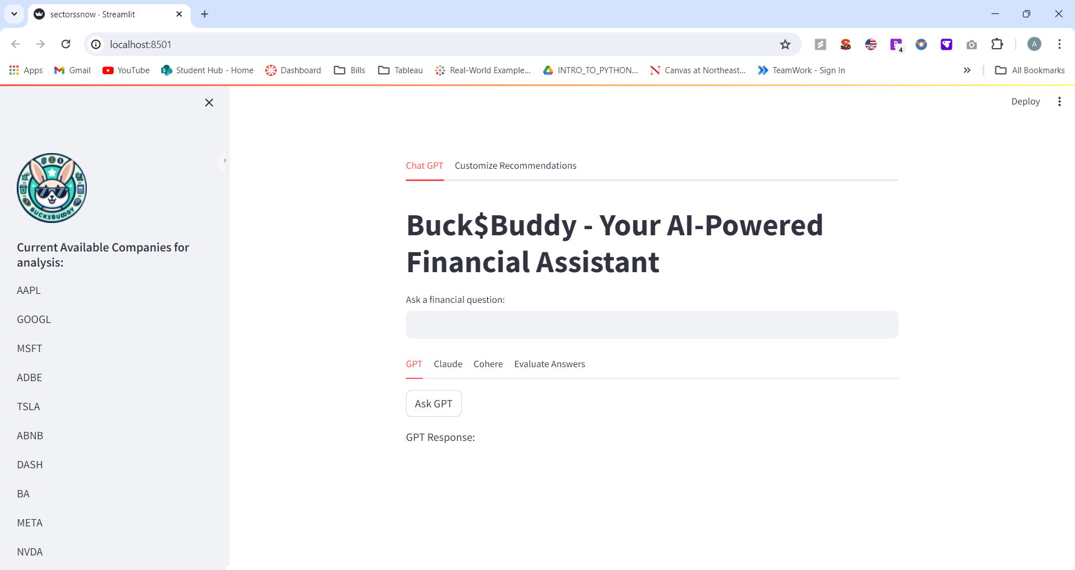
DEMO

Slide 11
REFLECTIONS
LLM Synergy
Data Precision
User-Centric Design
Strategic Simplification
Notes:
LLM Synergy:
Embraced the power of combining multiple LLM technologies to elevate financial analysis.
Data Precision:
Learned the value of precise data curation, particularly from social platforms, to enhance prediction accuracy.
User-Centric Design:
Constant focus on user experience drove the design of a friendly interface and relevant features.
Strategic Simplification:
Simplifying complex financial data into user-friendly insights became our guiding principle.

Slide 12

THANK YOU

